Slide 1
Send the notifications to user using serverless framework using external Authentication and Authorization
Sudhakar

Slide 2
API Gateway Lambda Authorizers
You have an external Authentication system (Hosted as Authentication and Authorization server) that handles user authentication and issue tokens for authenticated users and this same system needs to be used for AWS API Gateway endpoint security as well. Meaning the token issued from the external Authentication System needs to be passed for each and every request to the API Gateway as well. This is where Lambda Authorizers come in. You can create a Lambda function that will be invoked every time a request is made to an API Gateway endpoint and you can write your own custom code to verify that token sent to the request is valid by sending the token to the external Authentication system and check for validity.
Create an API Gateway.
Create Lambda functions.
Connect a Lambda function to an API Gateway.
Add Authorizers to AWS API Gateway.
Create SNS
Create the DynamoDB table

Slide 3







Authorizers
Target Lambda function
API Gateway

Slide 4
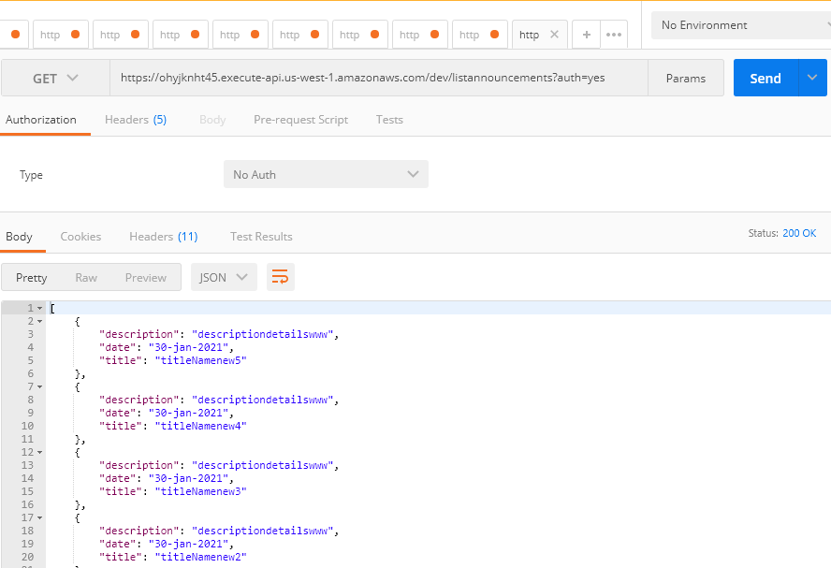
GET /dev/listannouncements?auth=yes HTTP/1.1Host: ohyjknht45.execute-api.us-west-1.amazonaws.comapproval: approveCache-Control: no-cachePostman-Token: c53a2b2e-5dde-2778-1ceb-a93814d769cf

Slide 5
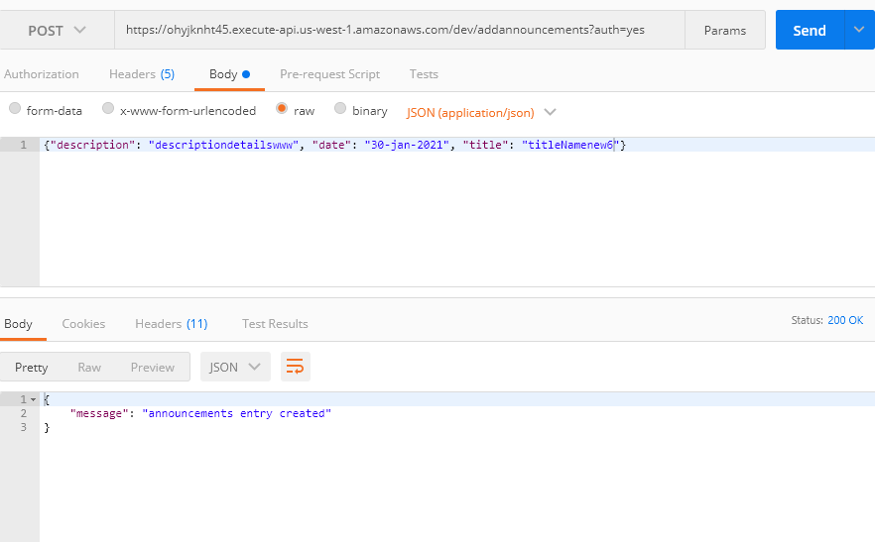
POST /dev/addannouncements?auth=yes HTTP/1.1Host: ohyjknht45.execute-api.us-west-1.amazonaws.comapproval: approveCache-Control: no-cachePostman-Token: 98dedfc0-1fb6-a0e3-c687-5f4e50c52f2c{"description": "descriptiondetailswww", "date": "30-jan-2021", "title": "titleNamenew6"}

